Slide 1
Odysseas Kopsidas
WILLINGNESS TO PAY METHOD FOR MEASURING THE EXTERNAL COST OF NOISE POLLUTION
Odysseas Kopsidas
Economist, Lawyer, MSc, PhD

Slide 2
The scope
The purpose of this study is to evaluate the environmental benefit of reducing noise pollution and express the benefits in monetary units using the technique of ‘Contingent Valuation Method’ (CVM).
Until now, the sound protection technology was paid by the citizens through taxation.
As the evaluation of the environmental benefit i.e. public good cannot be expressed by market forces, a modified version of the Contingent Valuation Method was applied.
With the scope of determining valuable feedback from the interviewees, we intend to examine how the citizens are willing to pay for the related expansion of noise barriers (WTP) along the regional highway of Thessaloniki in Greece.

Slide 3
Questionnaire
Questionnaires were distributed to residents in areas located along the peripheral highway of Thessaloniki and processing of responses was done using the SPSS - Statistics.
Measurements were made with a sound level meter after noise barriers were installed along the regional highway of Thessaloniki to calculate the noise reduction levels.

Slide 4
Questionnaire
The measurements showed that in areas where there were noise barriers, noise was reduced to about approximately 1/3 compared with no noise barriers.
It is proposed three alternative business models for noise reduction which are all responsible and taking into account the total macroeconomic social welfare.

Slide 5
Noise Pollution
The noise pollution caused by vehicles traveling on the ring road of Thessaloniki in Greece was conducted using noise measuring tools that provided the data associated with Experimental Economics.
Using that evaluation data we propose to develop a teaching method on the environment and to calculate the total benefit to the residents who live near and around the highway.

Slide 6
The basic idea
The basic idea of the valuation of environmental goods, as in the sound protection barriers, is based on the preferences of individuals (or householders) in relation to the environment, and the willingness to pay for the public good.
The option is either to enjoy the environmental good or alternatively to accept the loss of this environmental good.

Slide 7
Methodology
All the measurements were made with a special sound meter in situ and followed the same steps.
The measurements were made under the same conditions so that there is uniformity in the results.
The CASELLA, CEL 440 sound level meters, was placed at a height of 1.5 meters from the ground.
The sound level meter was positioned parallel to the ground and the microphone directed on the road.

Slide 8
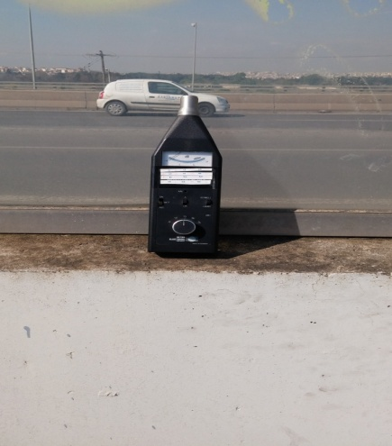
The CASELLA, CEL 440 sound level meters

Slide 9
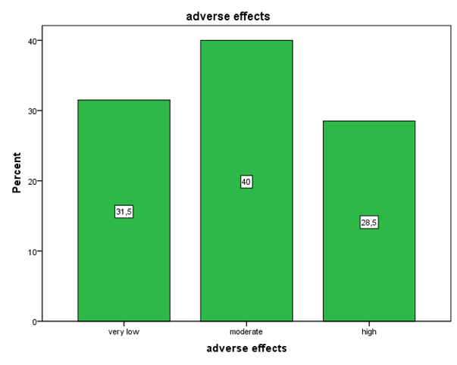

Slide 10
Figure depicts that 31.5% of the interviewees believe that the adverse effects of noise pollution near the road is very low, 40% thought it was moderate while 28.5% believe that it is high.

Slide 11
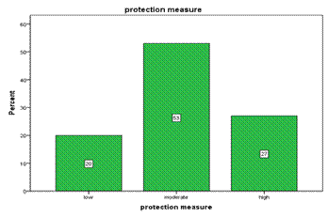

Slide 12
Figure depicts that 20% of the interviewees consider that the measurements taken by the authorities to protect areas from noise pollution caused by specific routes is negligible, 53% of interviewees believe that the noise pollution is modest and 27% of interviewees believe that it is high.

Slide 13
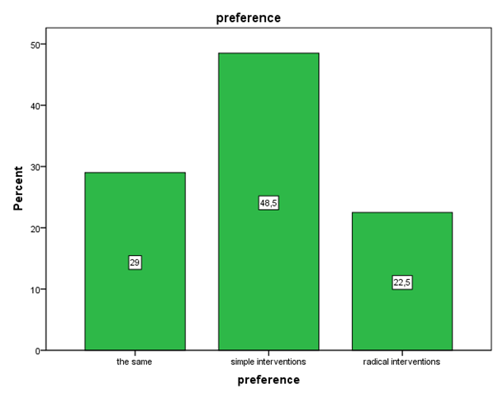

Slide 14
It is noted that 29% of the interviewees would like to leave the situation as is, 48.5% would like to make minimal changes, while 22.5% of respondents would like to make whole shell improvements.

Slide 15
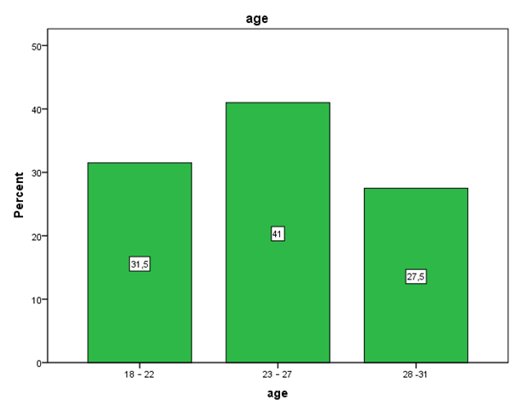

Slide 16
Therefore, it is presented some demographic data of the interviewees.
According to Figure, it is seen that 31.5% of interviewees were aged between 18-22 years old, 41% were aged between 23-47 years and 27.5% were aged between 28-31 years.

Slide 17
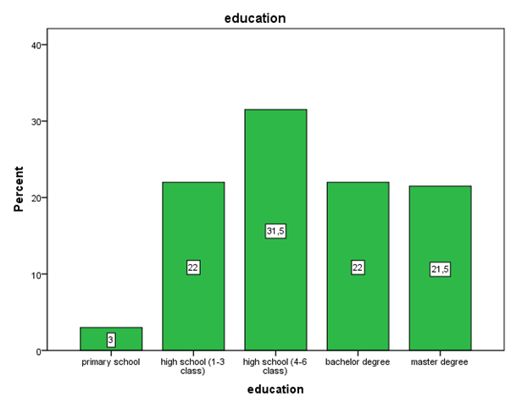

Slide 18
In Figure, it is seen that only 3% of the interviewees attended primary school, 22% have finished 3 years of high school, 31.5% have finished 6 years of high school, 22% of interviewees have university or technological studies and 21.5% of the interviewees have postgraduate studies.

Slide 19
Conclusion
There are three basic business models that can be examined for funding and implementing sound barriers technology.
The first business model is where the Government totally funds the project by borrowing money from private financial institutions hence increasing the national debt or raising revenue from increased taxes.

Slide 20
Conclusion
The second business model is where the project is funded by the citizens on their willingness to pay for the public good.

Slide 21
Conclusion
The third business model provides an opportunity for private industry to implement the necessary infrustacture based on an advertising model where profits are generated by selling advertisement space that is available on the sound barriers.
This solution has an opportunity cost where aesthetic pollution is moved from one location to another.
Furthermore, there is an opportunity for Government and private industry to collaborate.

Slide 22
Conclusion
The potential benefits from noise barriers provide improved living conditions and increase property values, this in turn will provide additional revenue to the Government, as the property is taxed at a higher value.
Private companies that will allocate funds to the project will benefit as being seen as environmentally conscious and environmentally responsible.
The noise barriers can be used by advertisement companies to sell advertisement space.
The revenue generated from the advertisement space will pay for the noise barriers, installation and maintenance.

Slide 23
Conclusion
This solution provides a benefit to all parties involved.
The municipality and the Federal Government will have a huge political benefit as a partner with private industry in the development of environmentally friendly infrastructure.
An additional benefit to the Government and taxpayer is a saving in healthcare costs as there is a less strain on the healthcare system.
Moreover, the sound reduction barriers maximize social welfare after limiting the environmental costs.

Slide 24
Conclusion
This work contains a framework for cooperation between the private and public sectors that potentially can generate multiple benefits without heavily impacting any social group or the environment.
Also, this work combines the Marketing and Management of Natural Resources with the fundamental issues related to Public Economics and its Administration.
Moreover, as argued by V. Pareto - an activity is beneficial to society when it improves the economic situation of certain individuals, without correspondingly worse socioeconomic status of others.
Then the activities of people tend to maximize social welfare.

Slide 25
Thank you for your attention!

