Slide 1
An Introduction to Taverna Components
Aleksandra Pawlik
Alan Williams
University of Manchester

Slide 2
What is a component?
Something that can be put into a workflow
Well described - what the component does
Behaves “well” - conforms to agreed good practice
Curated - someone looks after it
Produces and consumes data in agreed formats
Fails in described ways - meaningful error messages
Produces agreed type of provenance
Documentation
Example usage

Slide 3
Usefulness of components
Hide complexity
Predictable good behaviour
Guaranteed to work together
Can (in theory) check that data in a run conforms to the component specification

Slide 4
What is the agreement?
The agreement is a condition of being in a “component family”
Different domains, or even different uses within a domain, have different agreements
Astronomical data is not in the same formats as biodiversity data
Digital library components do not do the same tasks as biodiversity components
Agreement is formalized as a “component profile”

Slide 5
Implementation
A component family is
a pack on myExperiment, or
a directory on your local machine
A component is defined by a workflow (in a pack) in a component family pack
Components are versioned by the myExperiment’s versioning
Semantic annotations are stored in RDF as part of the workflow definition
Collated semantics, including workflow structure, are combined on myExperiment.

Slide 6
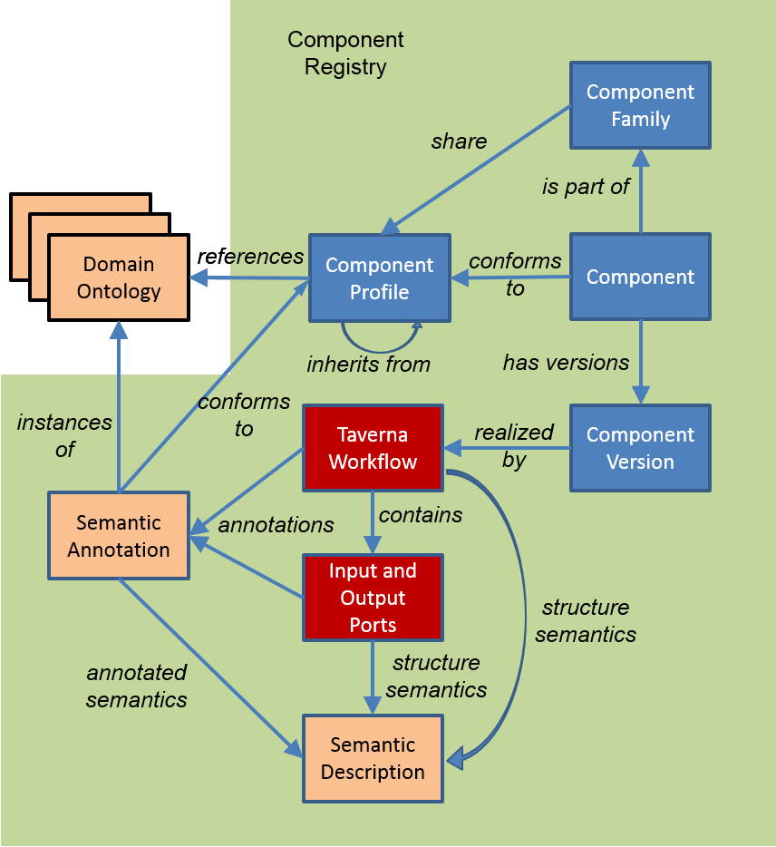
Implementation

Slide 7
Component pack
Contains:
Workflow ‘realizing’ the component
Example data
Documentation
Dependency specification

Slide 8
Component use
A component family is shown in the service panel of Taverna workbench
Components can be included within a Taverna workflow
Components are not simply the same as nested workflows
You could think of them as nested workflows that obey a set of rules and where you cannot see what is nested (and should not care)

Slide 9
Component creation
Components are created by annotating a workflow
Choice of a component family and so profile
Semantic annotation from the specified ontologies
Validation against the profile
Component saved into the component family
Can annotate:
Workflow
Input/Output ports
Services inside workflow
Extensions to myExperiment for
Pack snapshots
Semantic collation
Semantic searching

Slide 10
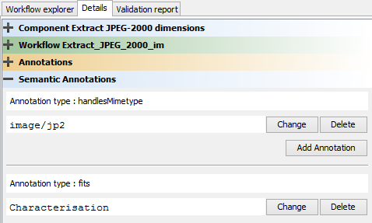
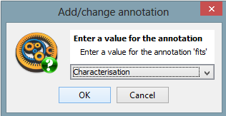
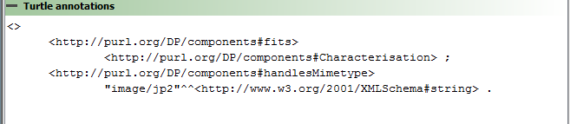
Semantic annotation

Slide 11
Effect on workflows
Use of components will allow
Component developers to work on the component
Component users to upgrade (or revert) the component versions
A workflow to remain ‘unchanged’ (if the component interfaces remain the same)
Powerful and dangerous
Proxies for components (re-run and re-play)
Components are “black boxes” in the workflow and workflow runs

Slide 12
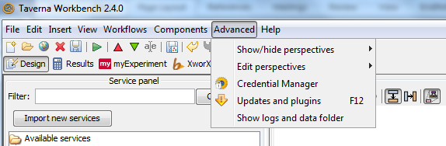
Taverna Components in practice
In this exercise we will create a component for the GBIF-related workflow you wrote before
First, we need to install the components plugin
Select “Updates and plugins” from the “Advanced” menu

Slide 13
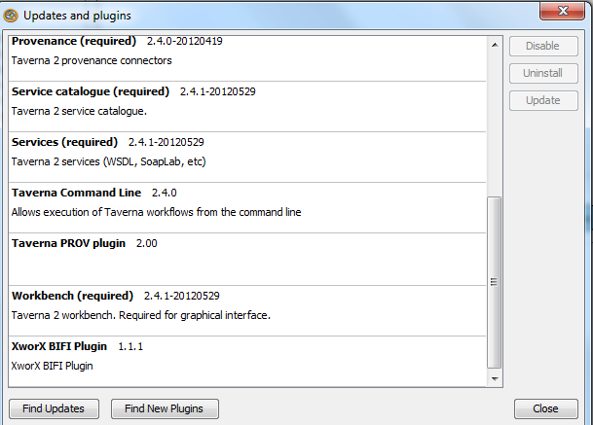
Taverna Components in practice
Search for the plugins – you should be able to find “Component Taverna plugin” and install it
Restart Taverna

Slide 14
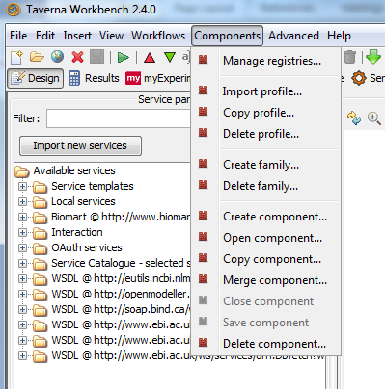
Taverna Components in practice
Now in the menu you should have a new option “Components”
First we need a Component profile
Select “Copy profile”

Slide 15
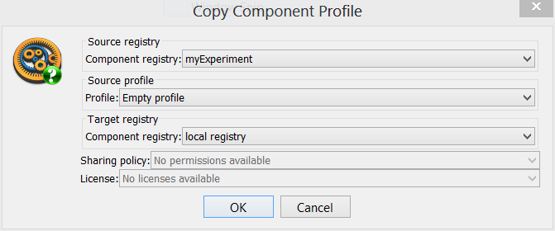
Taverna Components in practice
In the pop-up window choose the “myExperiment” source registry and copy the “Empty profile” to your “local registry”

Slide 16
Taverna Components in practice
In the “Components” menu
Select “Create family”

Slide 17
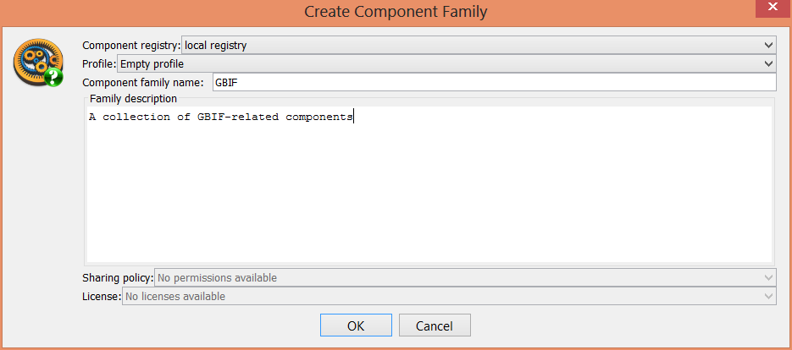
Taverna Components in practice
In the pop-up window set the registry to local
Enter the family name (“GBIF”)

Slide 18
Taverna Components in practice
Open the “Species_Occurrence” workflow that you made in the previous section

Slide 19
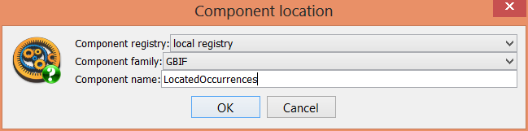
Taverna Components in practice
Select “Create component” from the “Components” menu
Provide a name for the component (LocatedOccurrences)
You should see a pink ribbon at the top
Save the component.

Slide 20
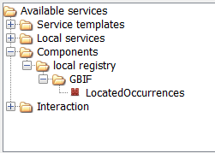
Taverna Components in practice
You should now see the component come up in the Service Panel.

Slide 21
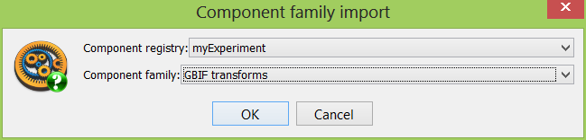
Taverna Components in practice
You can also include component families from myExperiment
Click on “Import new services” and select “Component service”
Choose “GBIF transforms” from the “myExperiment” component registry

Slide 22
Taverna Components in practice
Now we can create a new workflow linking the two components.
Create a new workflow
Include the “LocatedOccurrences” and “Extract_data_providers” components in the workflow
Add an input and an output port
Connect up the ports and services
Run the workflow

Slide 23
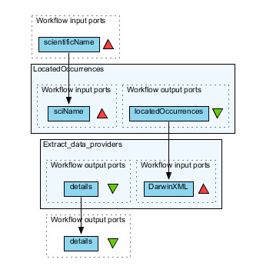
Taverna Components in practice

Slide 24
Taverna Components in practice
Run the workflow with a species name
You now know how to
Create components
Re-use components
Build a workflow from components

