Slide 1
An Introduction to the
Taverna tool service
Alan Williams
University of Manchester

Slide 2
What is a tool service?
Allows you to call a command line script as part of a workflow
  Simplest case is calling a single tool
Can be run on your local machine or a machine that you can ssh to
Data is passed by reference
  No big transfers to/from Taverna
Data kept where the script is run until/unless needed

Slide 3
Using a simple tool service
  Choose “Tool” from the “Insert” menu
  In the tool service popup type
  java –version
  Close the configuration
  Connect the STDERR and STDOUT ports of the tool service to workflow output ports

Slide 4
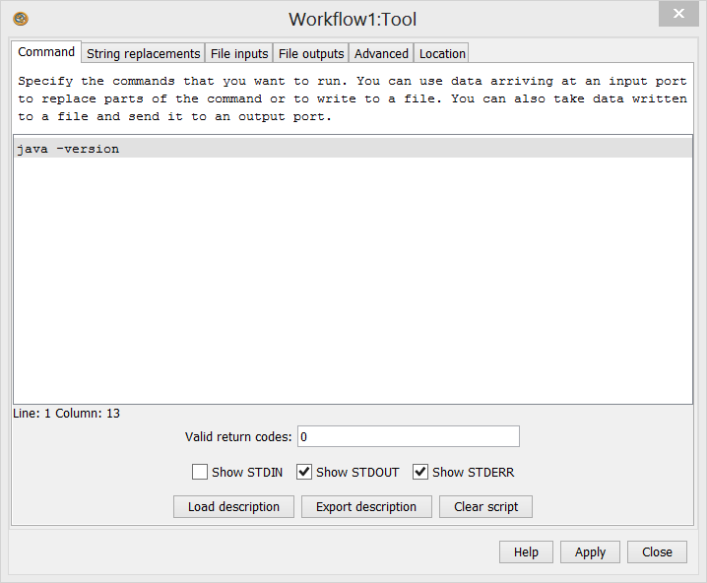
Simple tool service configuration

Slide 5
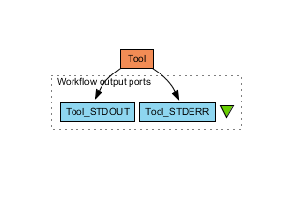
Simple tool workflow
  Run the workflow
  Tool_STDERR should start similar to
    java version "1.7.0_13"

Slide 6
Downloading an example tool
  We are going to use the forester utilities by Christian Zmasek
  Download
    forester_1028.jar from https://sites.google.com/site/cmzmasek/home/software/forester/download
  Remember where you downloaded it to

Slide 7
Calling the example tool - 1
  Create a new workflow with a tool service that calls the jar
    java -cp G:\alson\Downloads\forester_1028.jar
  Connect STDERR and STDOUT
  Run the workflow
  It fails. We cannot just call the jar

Slide 8
Calling the converter - 1
  We cannot just call the jar
  Look at https://sites.google.com/site/cmzmasek/home/software/forester/phyloxml-converter
  Change the tool service so the script says
  java -cp G:\alson\Downloads\forester_1028.jar org.forester.application.phyloxml_converter -f=nn infile outfile
  This converts the infile to PhyloXML and writes it to outfile
  Run the workflow

Slide 9
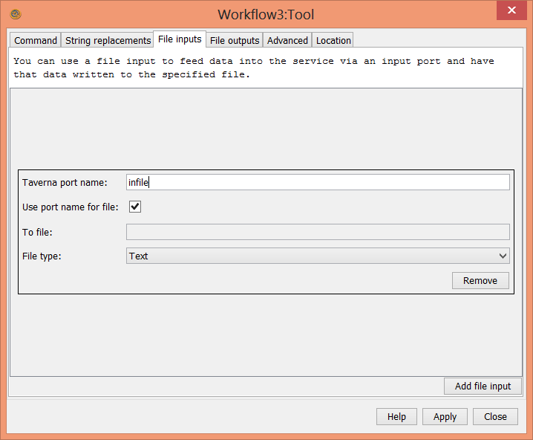
Calling the converter - 2
  We need to pass an input file
  Configure the tool service and add a file input called infile

Slide 10
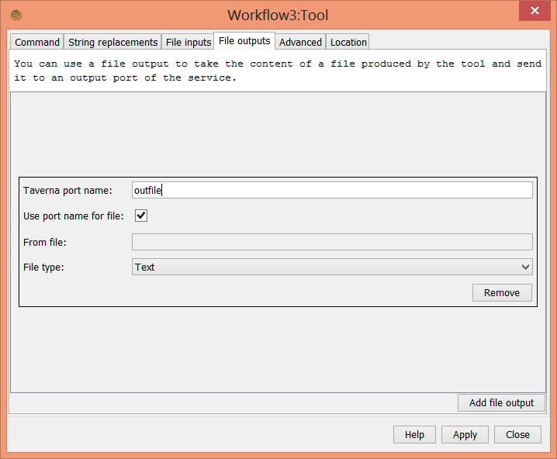
Calling the converter - 3
  Add a file output called outfile

Slide 11
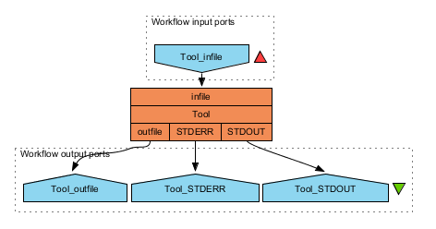
Calling the converter - 4
  The tool service now has two extra ports
  Connect infile to a workflow input port and outfile to a workflow output port

Slide 12
Calling the converter - 6
  Run the workflow
  You can use the contents of
  http://www.myexperiment.org/files/1055/versions/1/download/example.nh.txt
  as the input
  The outfile is in PhyloXML

Slide 13
Showing the PhyloXML - 1
  Rename the first tool to converter
  Add a new tool service that calls
  java -cp G:\alson\Downloads\forester_1028.jar org.forester.archaeopteryx.Archaeopteryx infile
  Add a file input called infile
  Rename the tool service to display
  Connect the outfile of converter to the infile of display
  Run the workflow

Slide 14
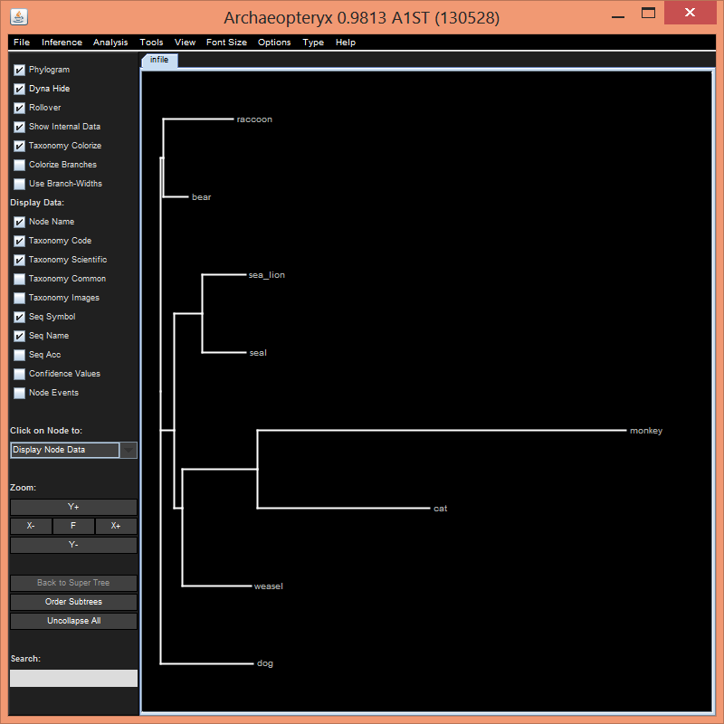
Showing the PhyloXML - 2
  The archaeopteryx display tool will show – exit it to finish the run

Slide 15
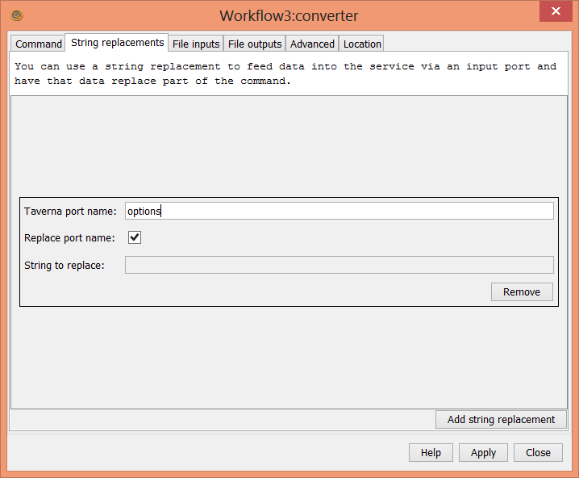
Using string replacement - 1
  PhyloXML converter can take options
  Add a new String replacement port to the converter service called options

Slide 16
Using string replacement - 2
  Change the converter script to include the options
  java -cp G:\alson\Downloads\forester_1028.jar org.forester.application.phyloxml_converter -f=nn %%options%% infile outfile
  %%options%% will be replaced by the string passed to the service
  Connect the options port to a workflow input port
  Run the workflow with options as the empty string
  Run the workflow with options as -o

Slide 17
Further exercises
  Create a component family in your local registry called forester
  Create a component in the forester family for the converter service
  Create a component in the forester family for the display service
  Make a workflow from the two components

