Slide 1



Biodiversity Virtual e-Laboratory
An e-Infrastructure and e-Science environment supporting research
on biodiversity
Norman Morrison
Senior Research Fellow, The University of Manchester

Slide 2
Your learning objectives
?

Slide 3
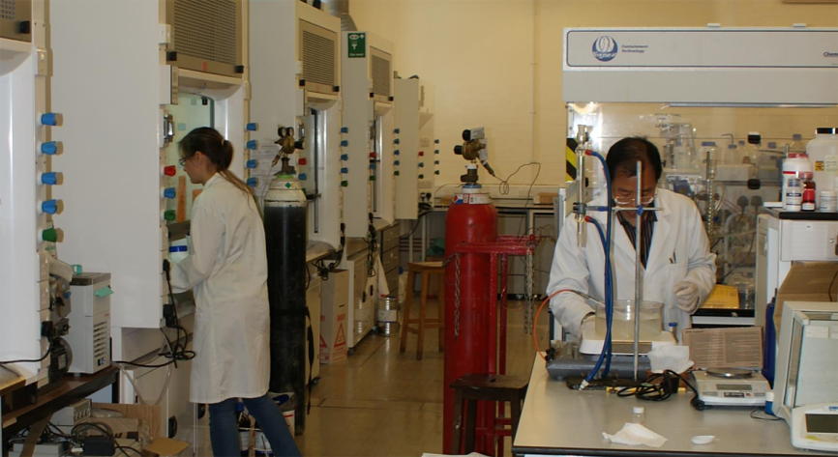
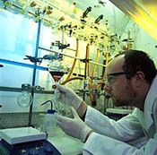
What is a Virtual e-Laboratory?
Like a physical laboratory
  A place “inside computers” where you can analyse data and do digital experiments
  It’s equipped with everything you need
    Workflows
    Services
    Data
    Hardware

Slide 4
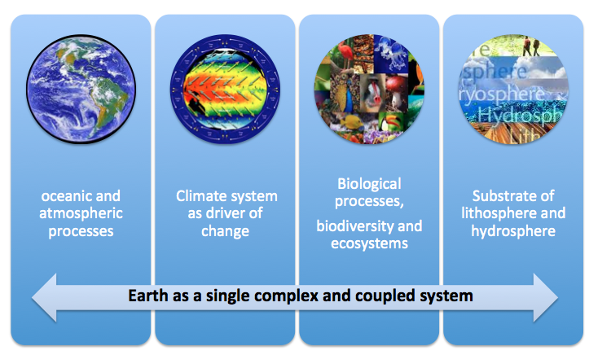
Scientific challenges in Environment
Source: W.Los

Slide 5
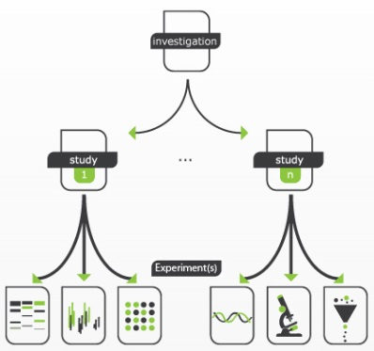
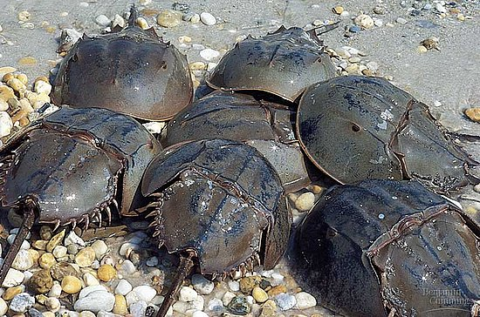
Workflows, pipelines and other applications are built from “services”
Workflows allow scientists to run studies and experiments to process vast amounts of data, repeatedly
  Select and apply successive “services” (data analysis and processing steps)
  Import data from own research and/or from existing public sources
  Choose input parameters
Access a library of workflows
  Re-using existing workflows improves efficiency by reducing research time and overhead expenses
Part of a workflow to study the
ecological niche of the Horseshoe crab (Limulus polyphemus)

Slide 6
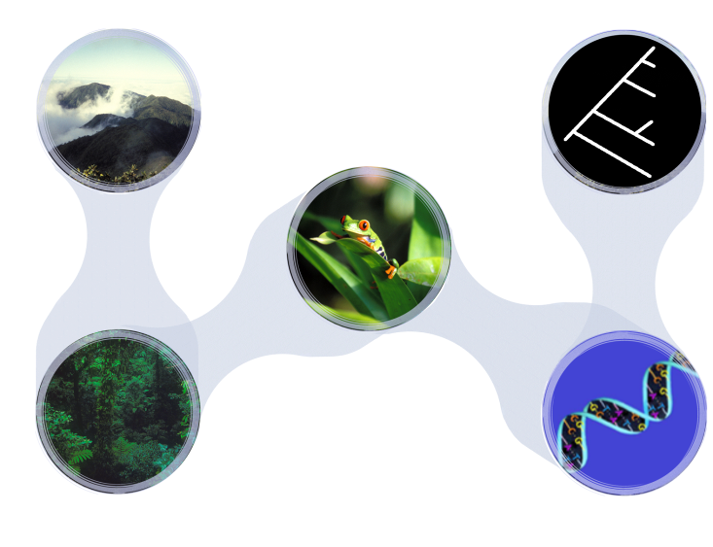
Biodiversity occurs on different levels of biological organisation and at different spatial and time scales
Ecosystems
Across time and
evolution
- some processes
act very fast
- others take
millions of years
Species
DNA, proteins and genes
Varying spatial scale
- from a single tree stump, forest stand, etc.
- to an entire landscape, country, or region
Source: W.Los

Slide 7
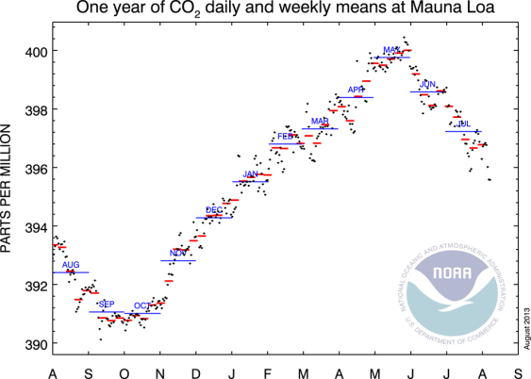
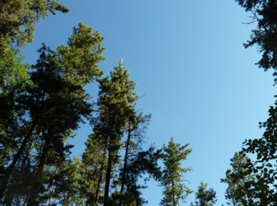
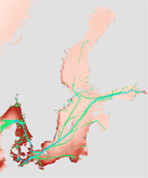
Workflows driven by science and policy needs
CO₂ emissions continuously increasing
  10 GtC in 2010; Sequestration is the sustainable process to mitigate the effects
Over the past 50 years, humans have changed ecosystems
  resulting in a substantial and largely irreversible loss of biodiversity
Invasions of alien species
  A leading cause of biodiversity loss and related economic damages. They degrade ecosystem services, generate human health problems and impact outdoor recreation.
Source: NOAA
“transportation with
ships is a high risk to
spread the species
to these spots”
Stelzer et al 2013

Slide 8
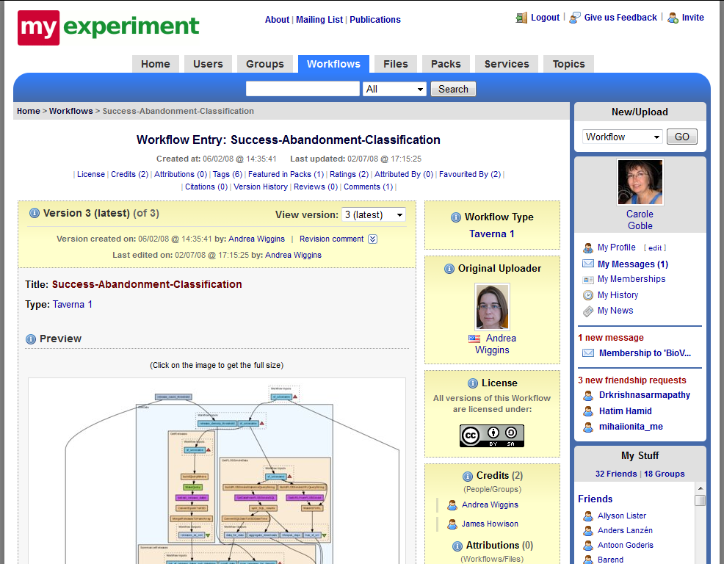
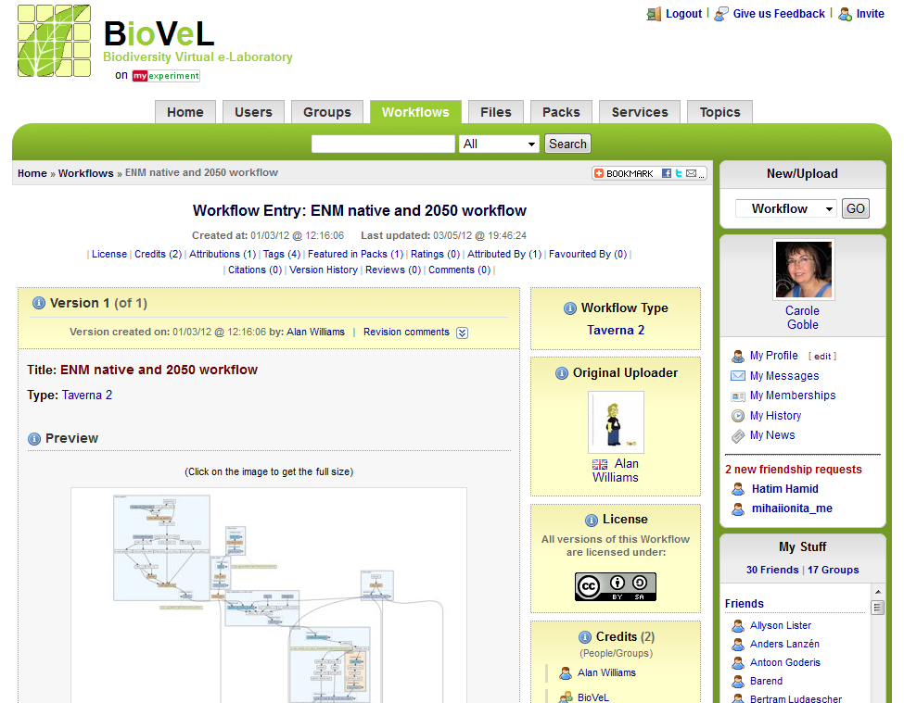
Workflows must be shareable and discoverable
www.myexperiment.org
8700 members, 318 groups, 2625 workflows, 674 files, 276 packs
Public groups
  Publishing workflows and results
Private groups
  Local materials
  Intra-project work and collaborations

Slide 9
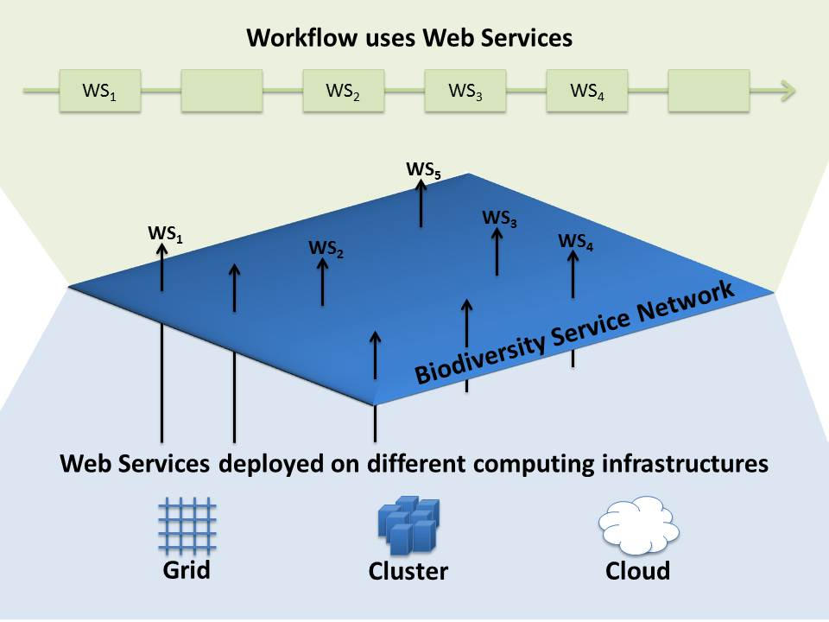
Secure, scalable, reliable, and well-documented in a geographically distributed network of services
Users’ workflows and
applications
Sustained Service and
Data Providers
GBIF, CoL, ITIS, OBIS, WoRMS,
EBI, BGBM, CRIA, EoL, BHL,
ALA, etc. + many many more
Recognised and stable
Resource Providers
National, EGI.eu, PRACE,
commercial, etc.

Slide 10
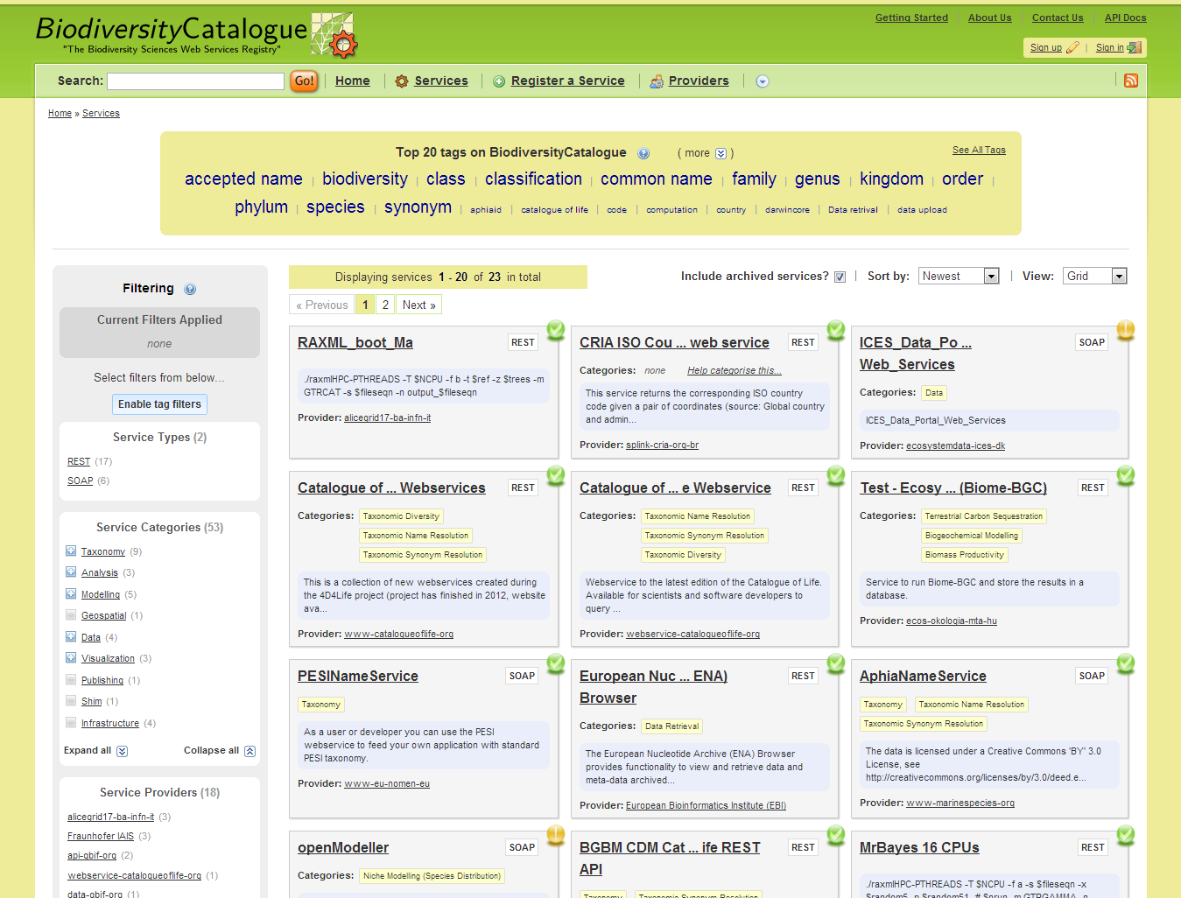
Services must be discoverable
www.biodiversitycatalogue.org
A fully curated, well-founded catalogue of
Web services for biodiversity science

Slide 11

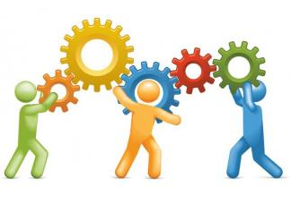



Workflow maturity process
Development
Consolidation
Release
Use Case
Showcase
Workshops
Demos
Disseminations
Conferences
Play Days
Tutorial
Training
Documentation
Documentation
Publication
Workflow
Management
Plan
Management
External
Users
Internal
Internal Service Team
External reviewers
Science and Tech Team

Slide 12




Users need to be able to build and use workflows
Workflow design, compute
Concept Knowledge
Domain science
Technical
PAL
Science
PAL
Domain
Scientist
Taverna
Workbench
Component
Builder
Taverna
Lite / Server
Taverna Player /
Domain-Specific
Website
High
Workflow Visibility
Low

Slide 13


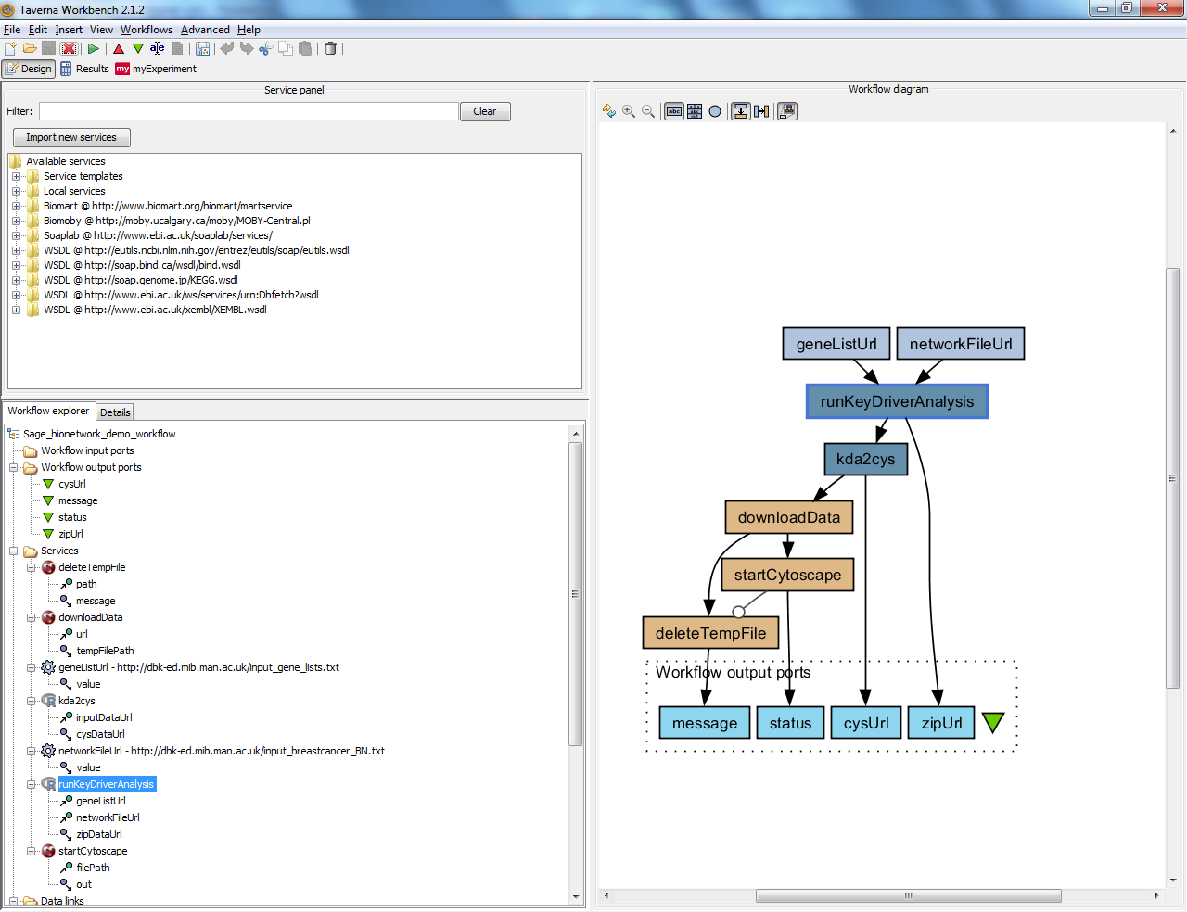


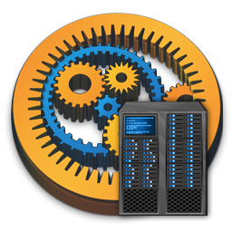






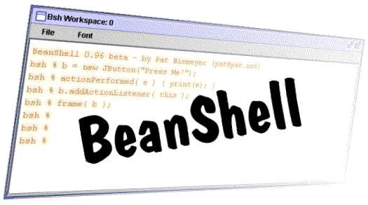
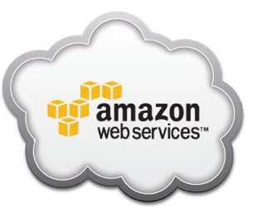

User facing
Expert Tools
Portal
Lite
Workbench
Taverna Player
Catalogues Repositories
Data &
Provenance
Servers
Run time
Execution
Biodiversity
Catalogue
Server
Services
Authentication
Management System
Server
SHIM
Interaction Server
Deployment
Infrastructure
hosting, compute, storage
Notes:
Doesn’t include provenance yet
Where do we report the WebDav stuff?

Slide 14
3 V’s of Big Data – Volume, Variety, Velocity
Variety
  Finding, retrieving and cleaning data prior to analysis is often a time-consuming task
  Data is not always neatly structured the way you want it for your analysis tools

Slide 15
Learning objectives for the course
How to building a simple workflow
How to import / export data from a workflow
How to use the Taverna engine to run your workflows
An introduction to the BioVeL Portal
What is a component… and how to create and use one
Embedding an R script in a workflow
Discovering and sharing workflows and services via myExperiment and Biodiversity Catalogue
Introduction to BioVeL Portal

Slide 16
Your learning objectives
How will what you’ve learned on the course impact your future research?
What benefits will using workflows have on your day to day activities?

Slide 17
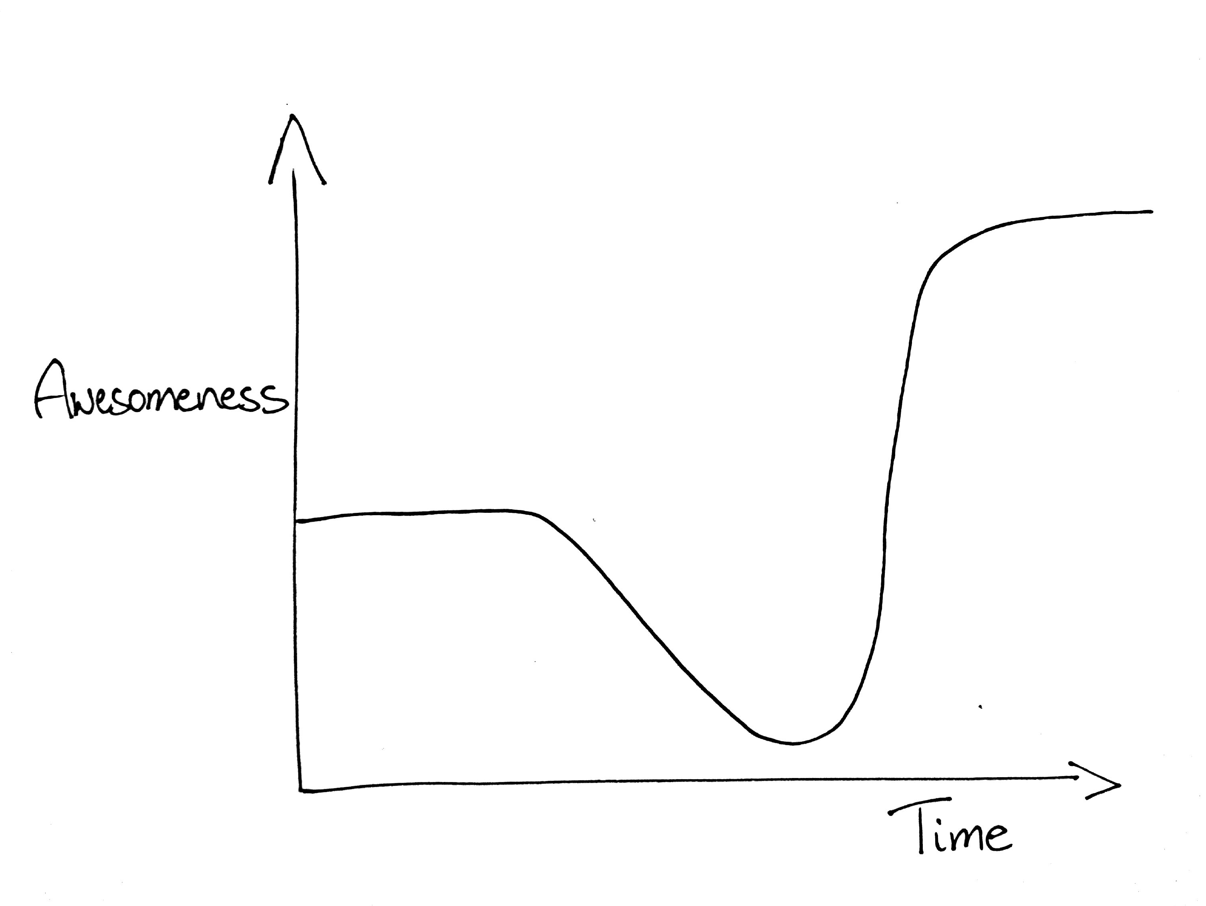

Slide 18
www.biovel.eu
BioVeL is funded by the
European Commission
7th Framework Programme (FP7).
It is part of its e-Infrastructures activity.
BioVeL contributes to LifeWatch and GEO BON.
BioVeL products are free to access.
Under FP7, the e-Infrastructures activity is part of the Research Infrastructures programme, funded under the FP7 'Capacities' Specific Programme. It focuses on the further development and evolution of the high-capacity and high-performance communication network (GÉANT), distributed computing infrastructures (grids and clouds), supercomputer infrastructures, simulation software, scientific data infrastructures, e-Science services as well as on the adoption of e-Infrastructures by user communities.

