Slide 1
Working with BioVel Portal
Aleksandra Pawlik
University of Manchester

Slide 2
Running your workflow in BioVel
In this short tutorial we will work with the BioVel portal
We will upload the workflow which we created during the previous session and run it in the portal
Go to portal1.at.biovel.eu and set up a user account

Slide 3
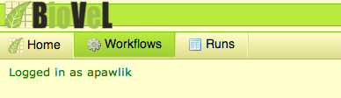
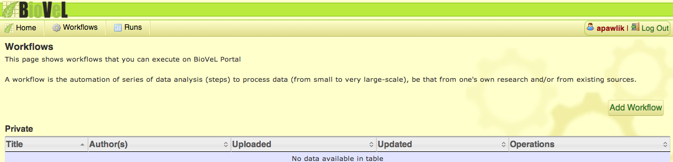
Upload the workflow to BioVel portal

Slide 4
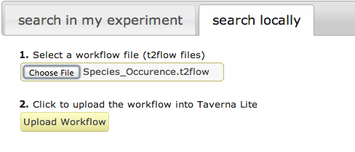
Upload the workflow to BioVel portal
You can upload a workflow from myExperiment or from your local drive

Slide 5
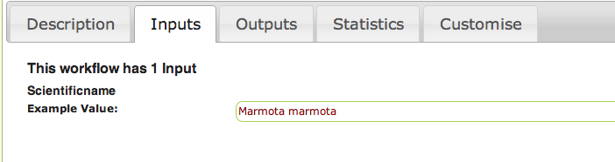
Upload the workflow to BioVel portal
As you can see all information that we included in the Workflow (Annotation) has been uploaded and is visible in the potal

Slide 6
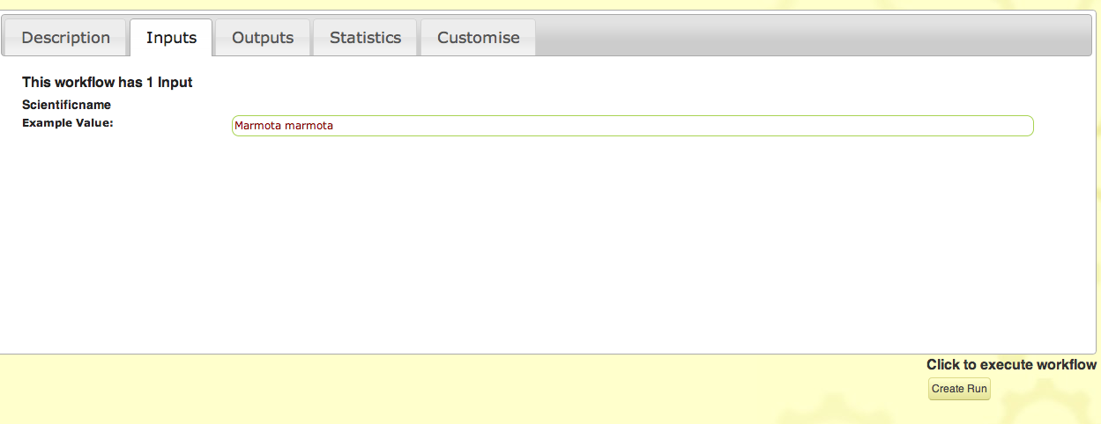
Upload the workflow to BioVel portal
Now we can run our uploaded workflow in the portal

Slide 7
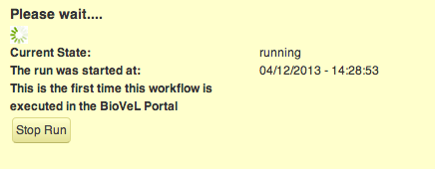
Running the workflow in BioVel Portal
And the workflow should run…

Slide 8
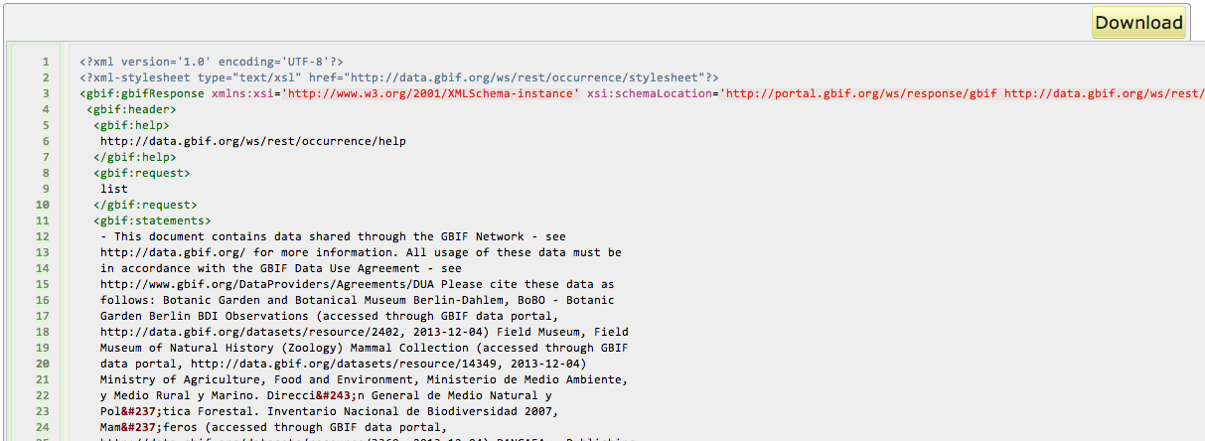
Running the workflow in BioVel Portal
And we get the results which we can download

