Slide 1
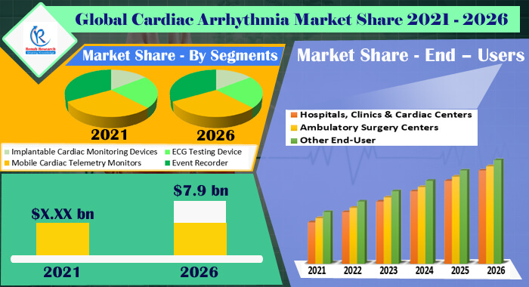
Cardiac Arrhythmia Market
Cardiac Arrhythmia Market

Slide 2

Report Description and Highlights
Globally, Cardiovascular diseases are the leading cause of mortality. According to the World Health Organisation, nearly 17.9 million global deaths occur due to Cardiovascular disease every year. According to the American Heart Association (AHA), more than 800 Thousand individuals die from cardiovascular diseases in the United States each year and nearly 92.1 million Americans are living with some form of cardiovascular disease. A cardiac arrhythmia is a condition where the person heartbeat is irregular, i.e., either, too slow, or too fast. Cardiac arrhythmia monitoring devices help in monitoring the patients who are at risk with heart arrhythmia. According to Renub Research Analysis, Global Cardiac Arrhythmia Market will be US$ 7.9 Billion by 2026.
Cardiac Arrhythmia Market

Slide 3
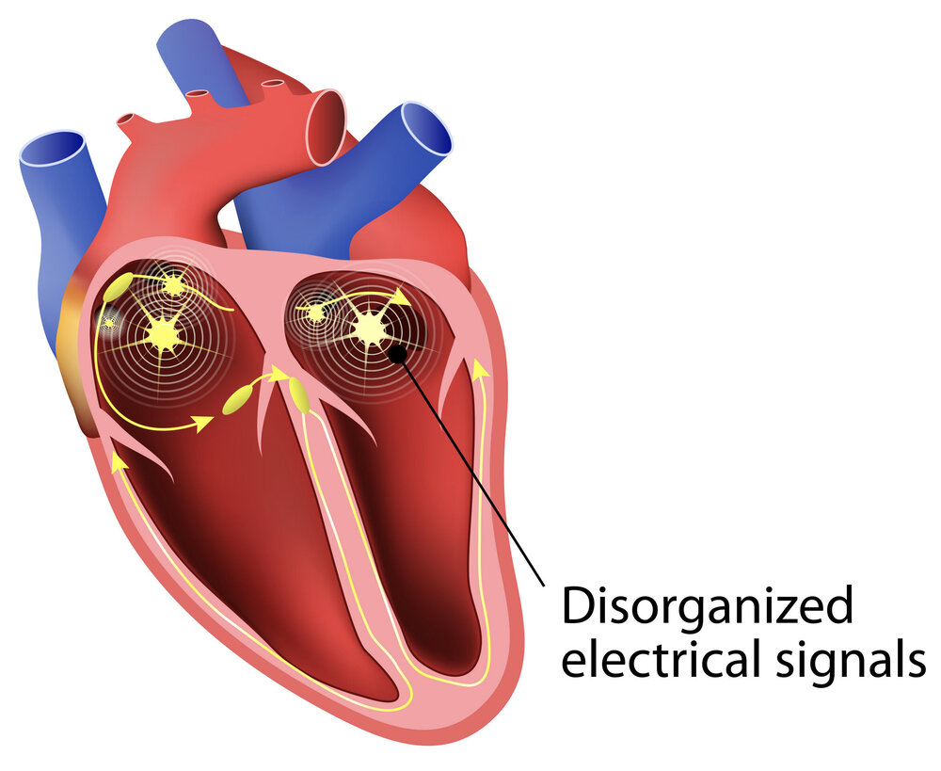
Cardiac Arrhythmia Market
What is Cardiac Arrhythmia and How Monitoring Device Helps?
People with cardiovascular diseases have increased risk of cardiac arrhythmia condition like tachycardia and bradycardia that need continuous monitoring to overcome sudden heart failure. When a heart rate is above 100 beats per minute in adults that it is called “tachycardia”. And when the heart rate of an adult is below 60 beats per minute than it is called “bradycardia”.
The cardiac arrhythmia monitoring device can monitor or record the electrical activity of the heart. These devices help in identifying the type and the cause of irregular heart rhythms. These devices help in continuously monitor the patients suffering from cardiac arrhythmia through remote patient monitoring.
Cardiac Arrhythmia Market

Slide 4

Cardiac Arrhythmia Market
Factors Driving the Cardiac Arrhythmia Market
Growth of telemedicine and the popularity of smartphone technology has changed the landscape of cardiac monitoring devices. Besides, key players operating in the market are competing based on advanced and connected cardiac arrhythmia monitoring devices which is expected to propel the growth of this market in upcoming years.
The driving force, which is boosting the global Cardiac Arrhythmia Market, is surging cases of lifestyle habits say obesity, smoking, excessive alcohol consumption. Some of the other factors include rising healthcare expenditure, rising consumption of tobacco and alcohol, accelerating economic growth, growing obese population.
Cardiac Arrhythmia Market

Slide 5
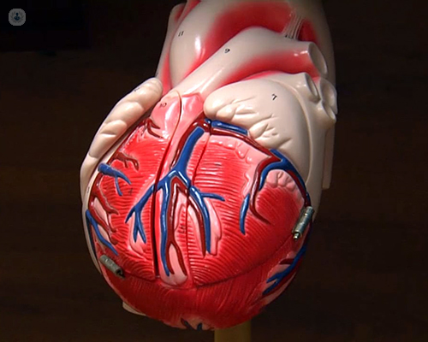
Cardiac Arrhythmia Market
Renub Research report titled “Global Cardiac Arrhythmia Market by Segment (Implantable Cardiac Monitoring Devices, ECG Testing Device, Mobile Cardiac Telemetry Monitors and Event Recorder), Region (North America (United States and Canada), Latin America, Europe, Asia Pacific and Rest of the World), End-User (Hospitals, Clinics & Cardiac Centers, Ambulatory Surgery Centers and Other End User) Key Players (Abbott Laboratories, GE Healthcare, Medtronic PLC, Koninklijke Philips NV, Biotelemetry, Inc.)" This report provides an all-encompassing analysis on the Global cardiac arrhythmia market
Request a free sample copy of the report: http://renub.com/request-sample-page.php?gturl=cardiac-arrhythmia-market-p.php
Cardiac Arrhythmia Market

Slide 6
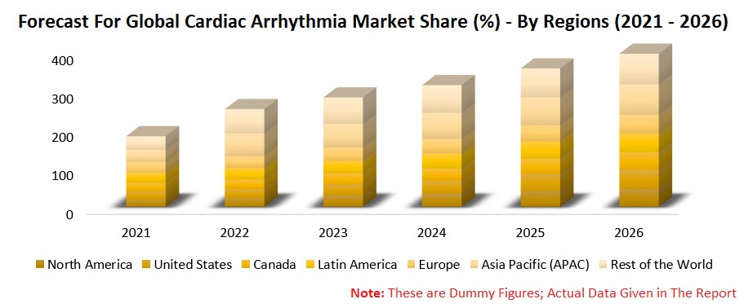
Cardiac Arrhythmia Market
Forecast for Global Cardiac Arrhythmia Market Share (%) - By Regions (2021- 2026)
Source: Renub Research Analysis Note: These are dummy figures; actual data given in the report
Cardiac Arrhythmia Market

Slide 7
Cardiac Arrhythmia Market
Segments – This report covers Market from 4 Viewpoints
• Implantable Cardiac Monitoring Devices • ECG Testing Device
• Mobile Cardiac Telemetry Monitors • Event Recorder
End – Users – Market breakup from 3 Viewpoints
• Hospitals, Clinics & Cardiac Centers • Ambulatory Surgery Centers
• Other End-User
Regions – Market breakup from all the 5 Regions
• North America • United States
• Canada • Latin America
• Europe • Asia Pacific (APAC)
• Rest of the World
Cardiac Arrhythmia Market

Slide 8

Cardiac Arrhythmia Market
All the key players have been covered from 3 Viewpoints
• Overview
• Recent Developments
• Revenue Analysis
Key Players
• Abbott Laboratories
• GE Healthcare
• Medtronic PLC
• Koninklijke Philips NV
• Biotelemetry, Inc.
Request a free Brochure copy of the report: https://www.renub.com/request-brochure-page.php?gturl=cardiac-arrhythmia-market-p.php
Cardiac Arrhythmia Market

Slide 9
Cardiac Arrhythmia Market
Industry Related Opportunity:
Cervical Cancer Screening Market, Global Forecast By Tests Pap Smear, HPV, DNA, VIA
Japan In Vitro Diagnostics (IVD) Market Share & Forecast By Diagnostics
Breast Cancer Screening Market Global Forecast by Screening Tests
Molecular Diagnostics Market Share & Global Forecast, By Application
Drug Abuse Testing Market, Global Forecast by Products & Region
Drug Abuse Testing Market, Global Forecast by Products & Region
Cardiac Arrhythmia Market

Slide 10






Contact Us
+1-678-302-0700 (US), +91-120-421-9822 (INDIA)
Visit us at:
https://www.renub.com
Stay with us:
Cardiac Arrhythmia Market

